Slide 1

Flight Price Predictor
Luis Cerrilla, Arthur Edwards, Kyle Cielencki and Ahasan Hossain

Slide 2
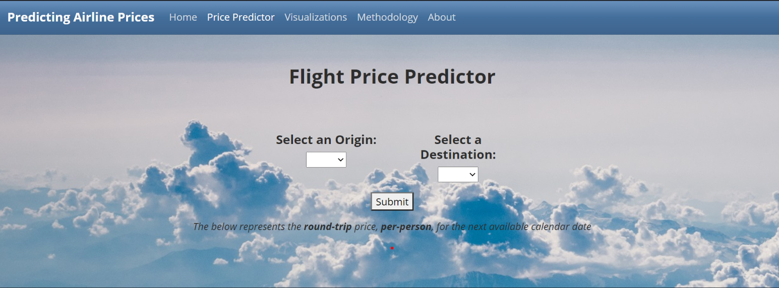
Introduction
For our final project we decided to create a flight fare predictor that would give you a price prediction based off a selected origin and destination
The dataset is from the Bureau of Transportation Statistics and goes as far back as 2017 to 2020 Q1
The data is visualized with Tableau into two different dashboards and the price predictor was made with D3. All hosted on an HTML webpage

Slide 3
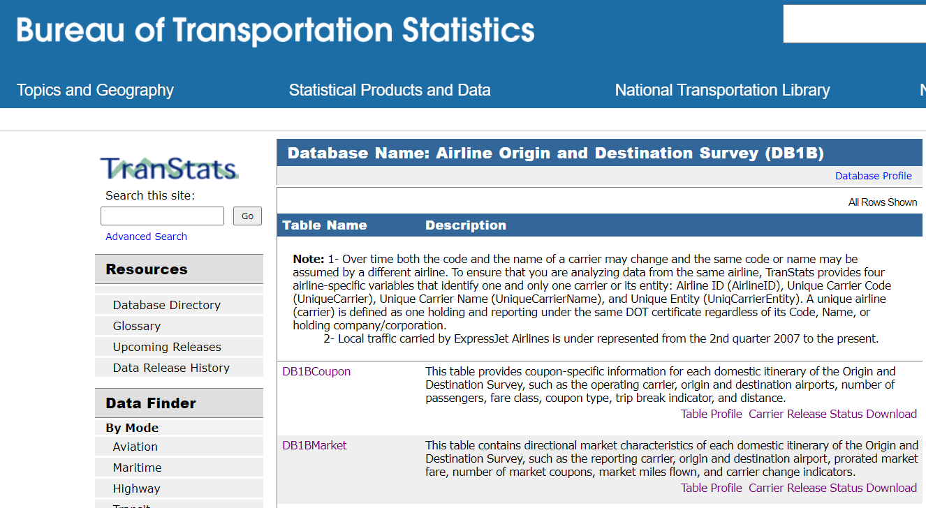
Data wrangling and cleaning
The data used in this app is from the Bureau of Transportation Statistics (“BTS”) quarterly Airline Origin and Destination Surveys.
To make meaningful visualizations, we pulled airport names, city names and coordinates (latitude, longitude). This required finding an appropriate dataset that contained these fields.
We joined this data to the BTS data using Python Pandas library.
Our visualizations are based on a random 5% sample of the last three years of data. This data was combined with an airport city, latitude and longitude for better visualizations.
Our flight price prediction model used a random 5% sample of Q1 2020 data from above.
Our model is based on the most recent quarter as this most accurately reflects the current travel environment.
For data cleanup, there were not any N/As to begin with.
However, we did notice some itineraries with well over 100 tickets. We narrowed our dataset to exclude any itineraries with less than 100 tickets.
Additionally, there were some itineraries that cost as much as $20,000. We excluded any itineraries that cost more than $2,000.
The total dataset from the BTS was over 11.6GB, this meant taking a smaller sample size to visualize

Slide 4
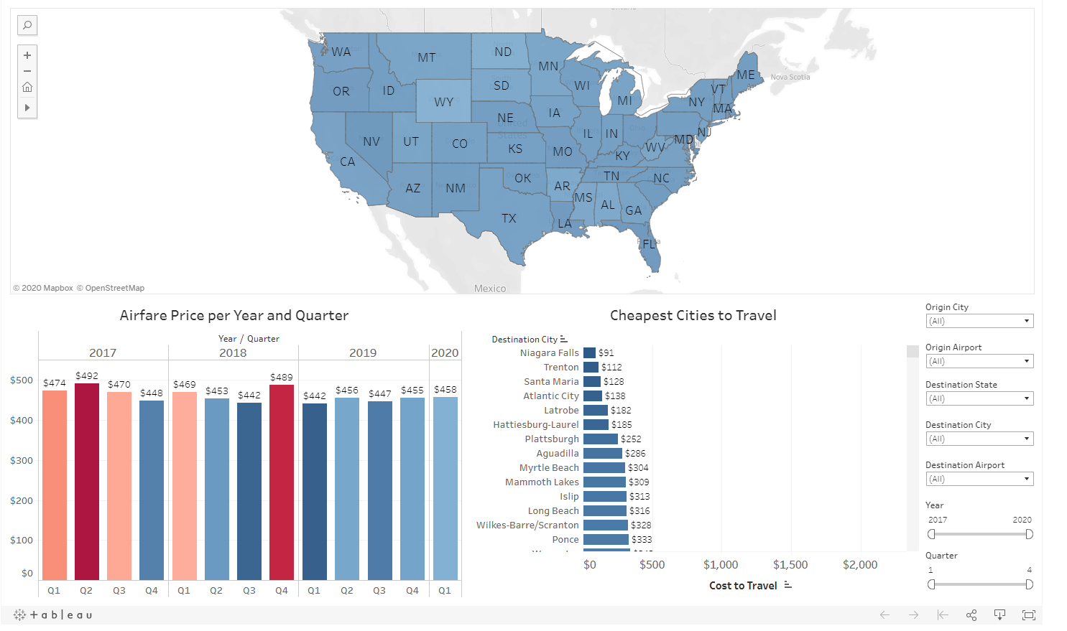
Tableau Dashboards
Provides historical flight data since 2017
The map provides an overview of the average cost to travel to a specific state
The bar graphs show prices segmented in different years and quarters
The horizontal bar graph show average cost to travel to a specific city

Slide 5
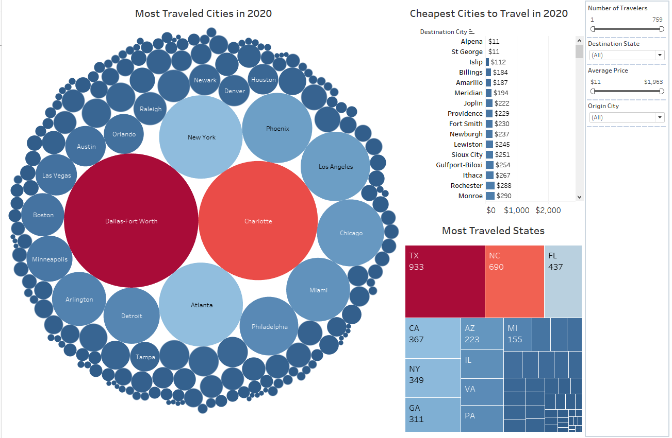
Tableau Dashboards
The Second Dashboard shows most traveled cities and states across the U.S. in Q1 2020.
The bubble chart and the tree-map highlight which city and state contains the most travelers recorded in 2020 Q1
The bar-chart displays cheapest cities to travel to in the U.S. the chart is sorted from least to greatest

Slide 6
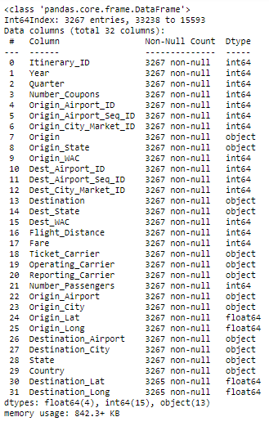
Machine Learning
The purpose of the machine learning model is to predict the fare for domestic flights in the USA territory given only two inputs, origin airport code and destination airport code.
To accomplish this purpose the dataset had to be fitted, trained and tested.

Slide 7
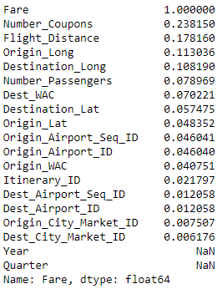
Machine Learning
To build this model we needed a correlation between the Fare column, and the rest of the columns.
With that result we decided to use the columns that had more than 5.6% correlation
Then we fit the data and divided it into 80% for training purposes, and 20% for testing purposes. These parameters will apply to all the tested models.

Slide 8
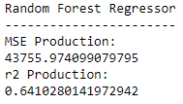
Machine Learning
Out of the 22 models the Random Forest Regressor model had the best results, which is the model we picked
Other models like the Linear Regression model also had good results

Slide 9
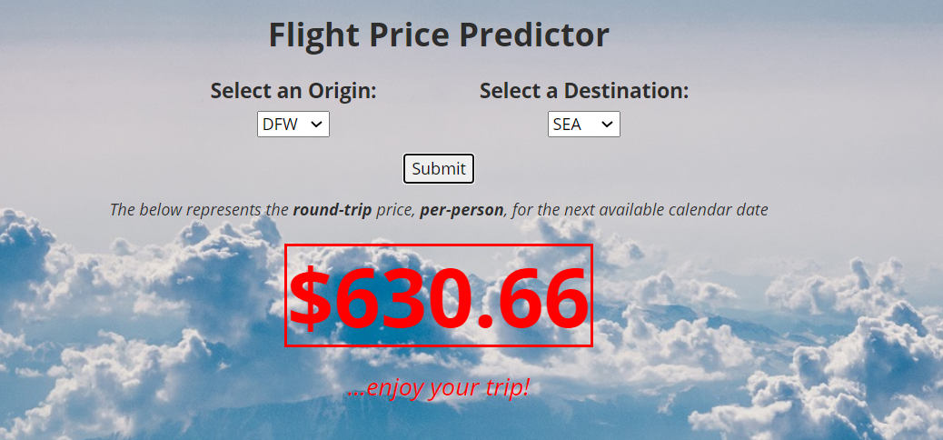
Website Presentation and Combining the Work
We deployed our site on Heroku and laid out our analysis and prediction model on five pages (Home, Price Predictor, Visualizations, Methodology, About)
Utilizing Bootswatch, CSS and D3 event listeners, we were able to create a meaningful website for our end-users

Slide 10
Issues and Hurdles
The dataset is segmented into quarters, not months. Would’ve been nice to have been an API instead
Most recent data is Q1 2020
Dataset was too large. The original dataset was more that 500MB
Having only used a partial amount from our dataset may have led to a few outliers
COVID may have also skewed the data as well

Slide 11
Demo

